Slide 1
TechLadies Mentee Journey
Data Science

Slide 2
Predicting Students’ Grade Categories Project Using R

Slide 3
Rise of Online Learning
Covid-19 increased prevalence of remote learning
Even before the pandemic, Research and Markets forecasts the online education market as $350 Billion by 2025
Allow learners to learn fast and at their own pace
Give better help to students if educators can identify those that need more help through prediction

Slide 4
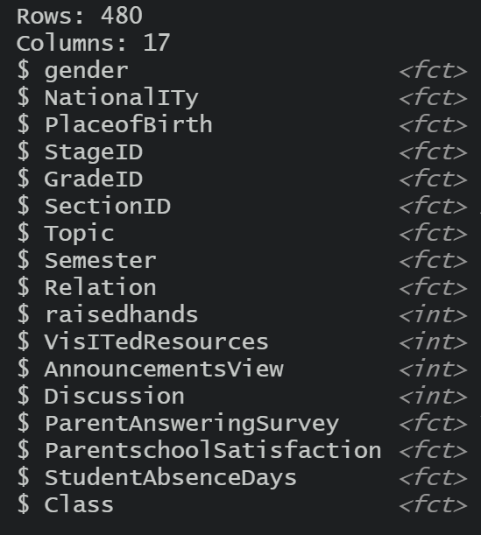
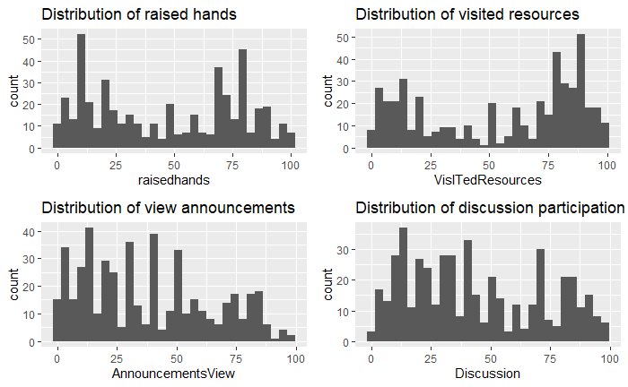
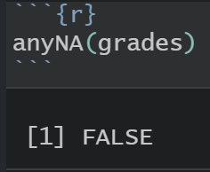
Data Exploration

Slide 5
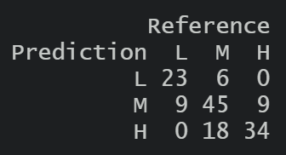
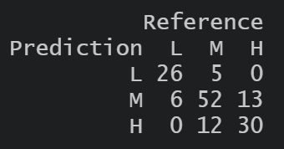
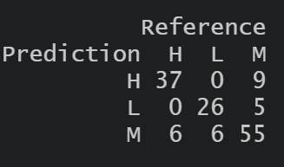
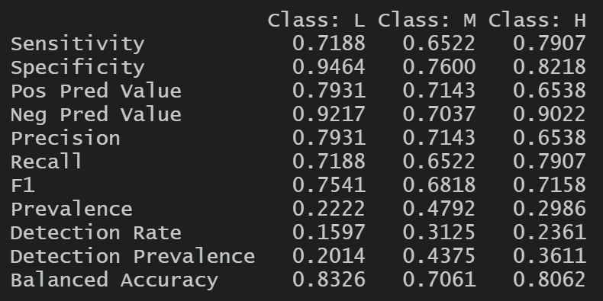
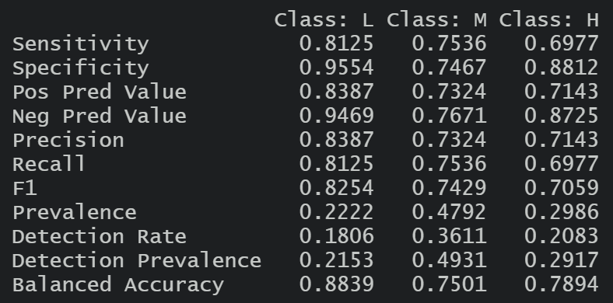
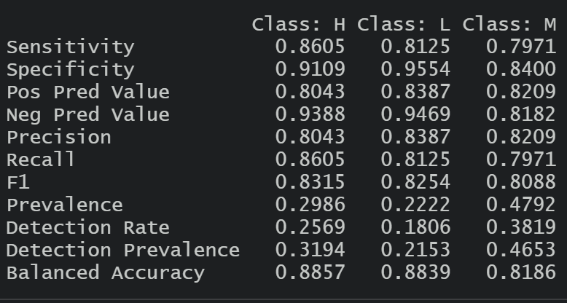
Results
Decision Tree | Random Forest with Bagging | Support Vector Machine
70.83% | 75% | 81.94%

Slide 6
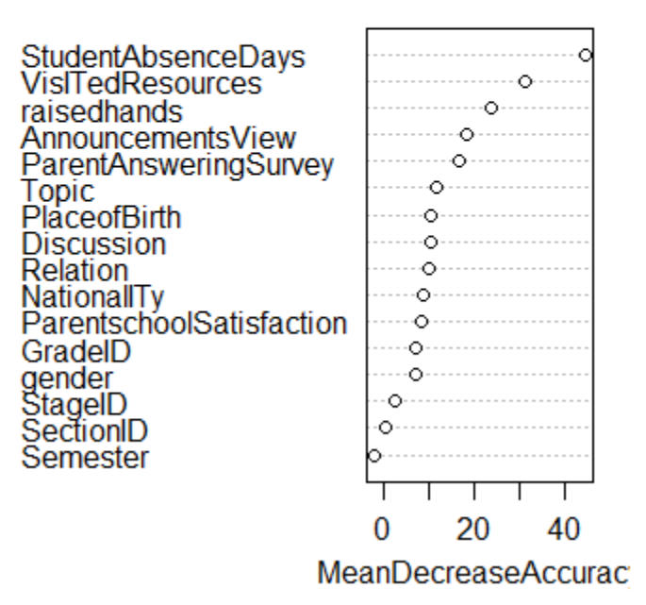
Additional Findings
Top 5 most important variables:
Student Absence Days
Visited Resources
Raised Hands
Announcements View
Parent Answering Survey
Variable that worsen accuracy of model : Semester

Slide 7
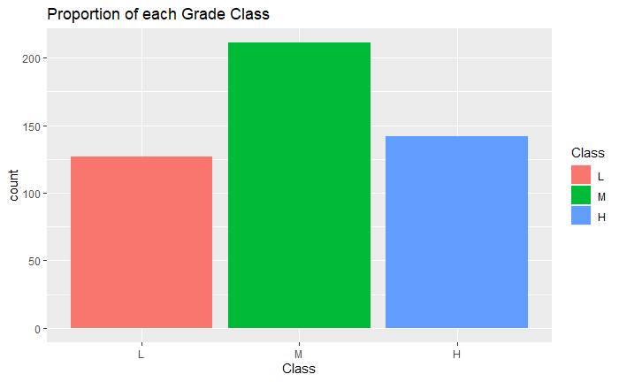
Improvements
Explore Stratified sampling / methods that will balance data
Explore Gradient Boosting for Random Forest

Slide 8
Thank you!

